Slide 1
Triangulation of polygon
Dynamic programming

Slide 2
What is a polygon ?
A polygon is a two-dimensional geometric shape made up of a finite number of straight-line segments connected to form a closed loop.
The line segments are called edges or sides, and the points where two edges meet are called vertices.
s.
A polygon is a two-dimensional geometric shape made up of a finite number of straight-line segments connected to form a closed loop. The line segments are called edges or sides, and the points where two edges meet are called vertices.

Slide 3
Characteristics of a polygon
1. Closed Shape: All edges connect end-to-end to form a closed boundary.
2. Straight Edges: Each edge is a straight line segment.
3. Vertices: The corners or points where two edges meet.

Slide 4
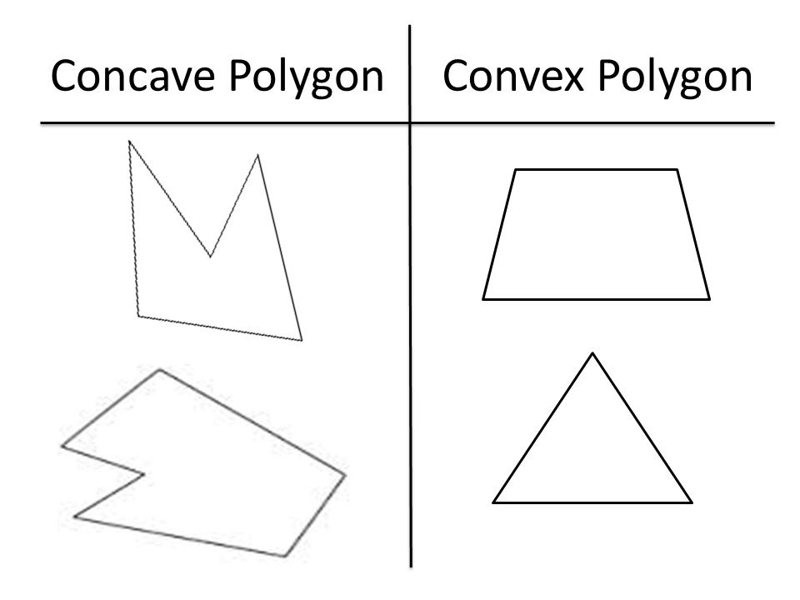
Types of polygons
1. Convex Polygon: A polygon where all interior angles are less than 180 degrees, and any line segment between two vertices lies inside the polygon.
2. Concave Polygon: A polygon with at least one interior angle greater than 180 degrees.

Slide 5
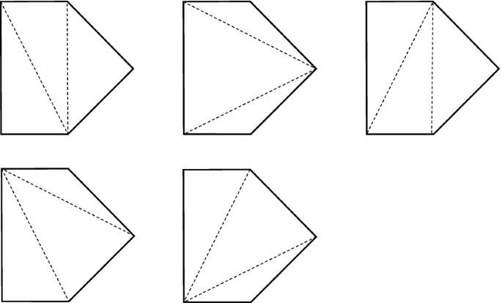
Triangulation Definition:
The process of dividing a polygon into smaller, non-overlapping triangles such that the union of these triangles is equal to the original polygon.

Slide 6
Finding no of ways
Catalan number = (2n)! / (n+1)! * (n)!
We can triangulate the given n sided polygon in Catalan number of ways

Slide 7
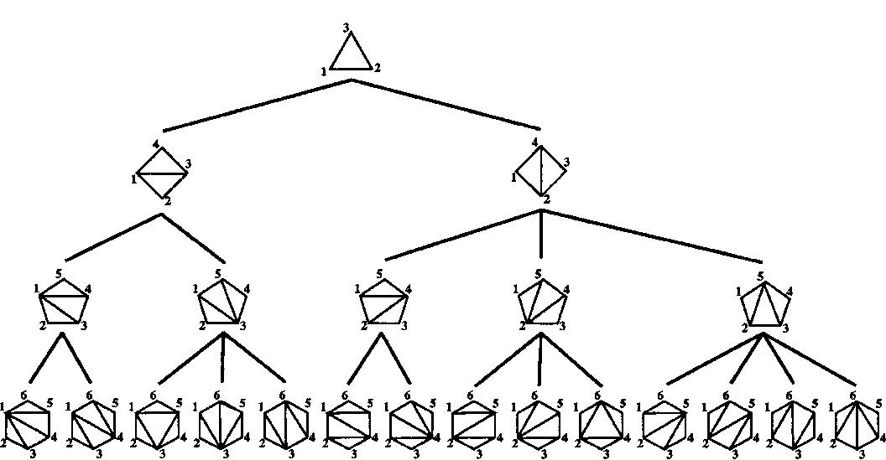
Using dynamic programming
Example : six sided polygon

Slide 8

• Let C(i, j) represent the minimum cost to triangulate the polygon formed by vertices Pi, P{i+1},….. , Pj .
• The total cost includes the cost of a diagonal Pi Pk and the costs of triangulating the two sub-polygons Pi, Pk and pk,pj. and P_k, P_j .
Using dynamic approach:
For i < j - 1 (at least a triangle is needed):
C(i, j) = min {i < k < j} (C(i, k) + C(k, j) + cost(Pi, Pk, Pj))
cost(Pi, Pk, Pj) is typically the perimeter or area of the triangle Pi, Pk, Pj , or just the length of diagonal Pi, Pj.
Base Case: C(i, j) = 0 if j = i + 1,
No triangulation is needed for two vertices.

Slide 9
3
2
3
4
2
1
4
3
3
2
3
4
4
3
2
3
2
1
4
3
2
1
4
3

Slide 10
C13=C12 + C23+cost(1,2,3)
C24=C23 + C34 +cost(2,3,4)
K=2
C14=C12 + C24 +cost(1,2,4)
K=3
C14=C13 + C34 +cost(1,3,4)
C(1,2,4)=60
C(1,3,4)=48
 | 1 | 2 | 3 | 4
1 | 0 | 0 | 24 | 48
2 | 0 | 0 | 0 | 36
3 | 0 | 0 | 0 | 0
4 | 0 | 0 | 0 | 0

Slide 11
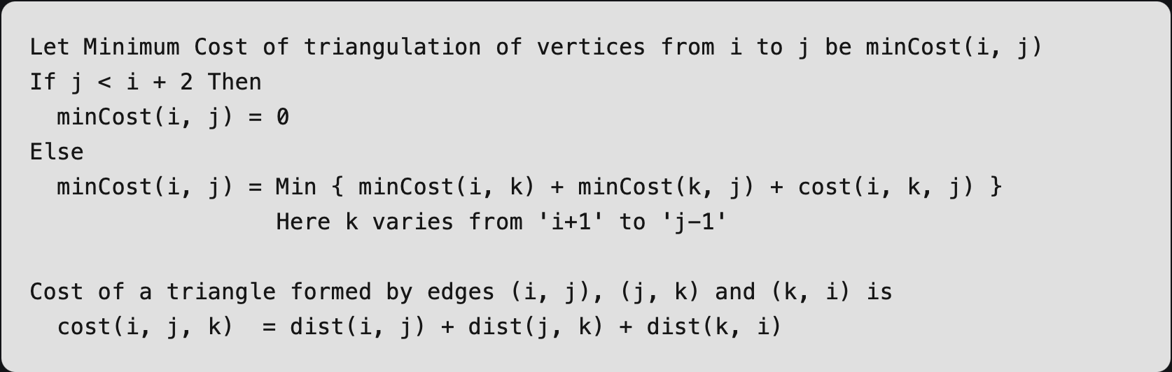
Recursive Approach:
Considering the Pentagon
The idea is to divide the polygon into three parts: a single triangle, the sub-polygon to the left, and the sub-polygon to the right.
We try all possible divisions like this and find the one that minimizes the cost of the triangle plus the cost of the triangulation of the two sub-polygons.
Pseudo Code:
Time Complexity for this Approach is: O(2^{n})

Slide 12
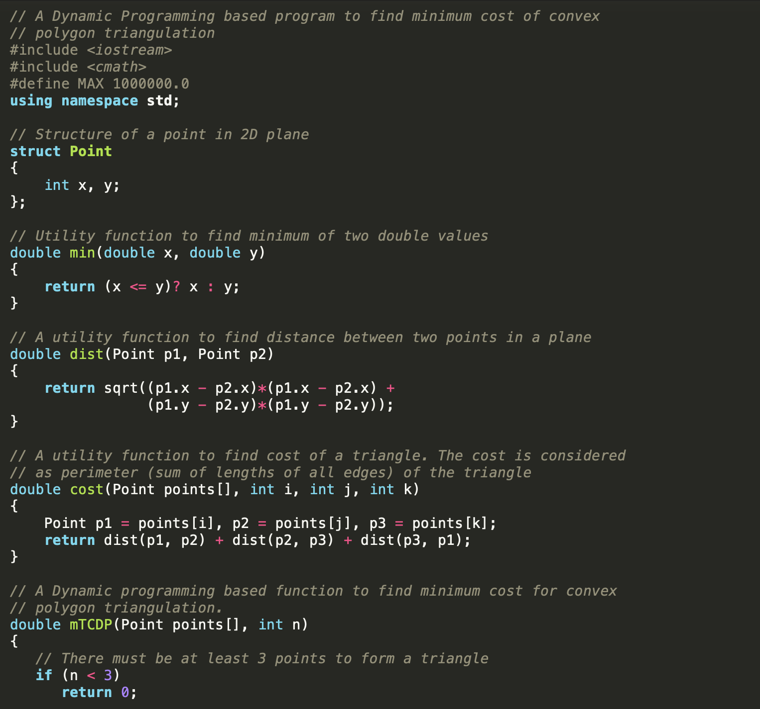
Dynamic Programming Implementation in C++ previous Pentagon
(0,2)
(1,2)
(2,1)
(0,0)
(1,0)

Slide 13
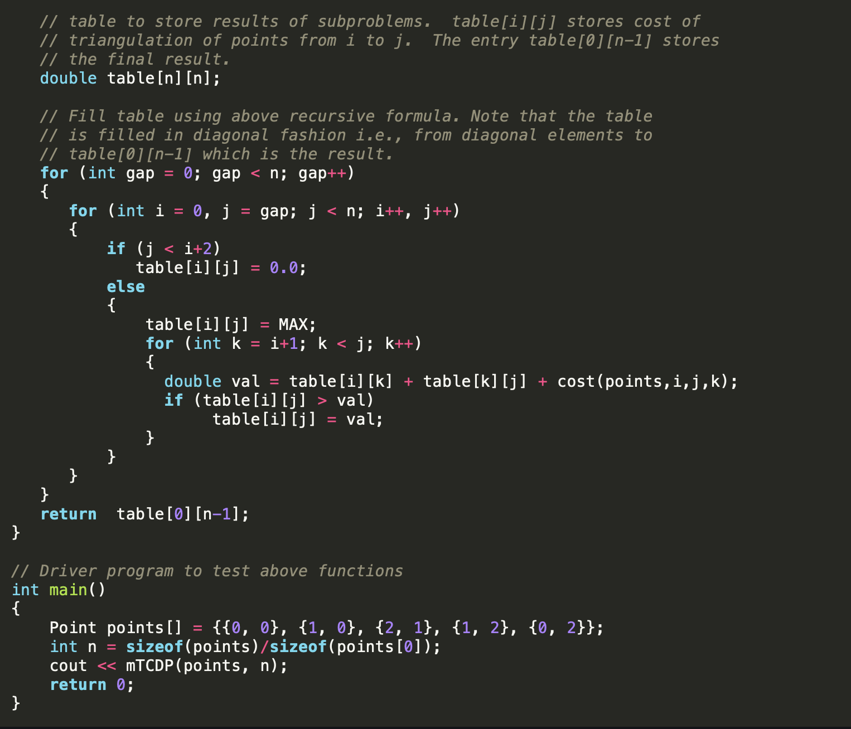
      This approach is similar to matrix chain multiplication,So the time complexity of this approach is:
      T(n)= O(n³)

Slide 14
Thank You
Presented by
-Manthankumar Patel
-Sahith Reddy

